Slide 1
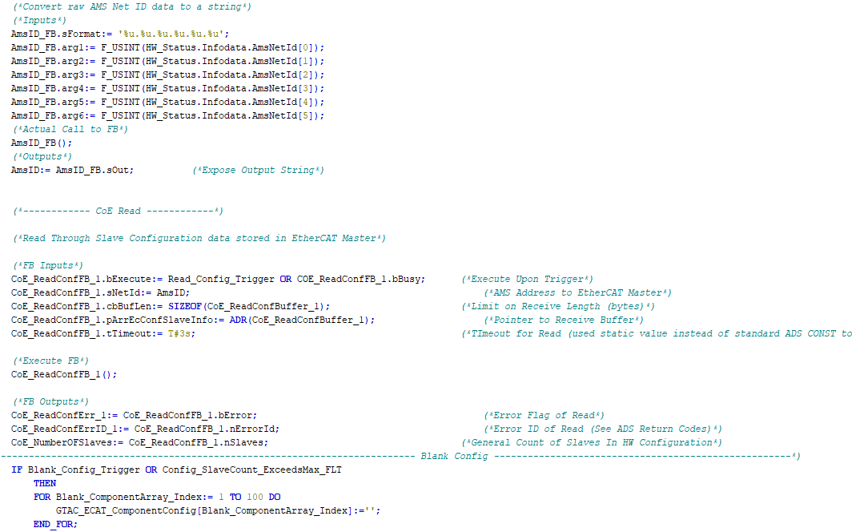

Controls Training
Part 4:
Safety Liability

Slide 2
Some Statistics
In 2018, there were a total of 5260 workplace deaths in the US.
The majority of these deaths are broken down as follows:
2080 were killed in transportation related accidents
791 died due to slip and fall accidents (down 11% from 2017)
786 died by contact with objects / equipment including caught in running machinery (up 13% from 2017)
305 deaths were related to overdoses via non-medical drugs or alcohol (up 12% from 2017)

Slide 3
Liability
When a worker gets hurt or killed at their workplace, the employer is generally legally responsible on some level, no matter the circumstances. Why? Because an employer is required, by law, to provide a safe workplace. The level of guilt (IE level of legal charges) and who with-in the company bears the liability depends primarily on two things:
The severity of the accident
Due diligence
- reasonable steps taken by a person in order to satisfy a legal requirement

Slide 4
Others Involved in Liability
Does this mean that only the employer and those who work with-in the workplace where the accident happened can be found guilty?
ABSOLUTELY 100% NO!
Lack of Due Diligence can have far reaching consequences

Slide 5
Case #1
Williams vs Litton
Who is Robert Williams?
In the 1970s Litton Industries designed and built a 5 story robotic system for retrieving castings from a rack based storage system. It was installed at the Ford Motor Company’s new Flat Rock plant in Michigan
January 25, 1979 - Robert Williams was asked to climb into the racks to retrieve a part manually after a robot failure
The machine started unexpectedly, crushing Robert, killing him instantly
Robert Williams was the first person in history to be killed by a robot

Slide 6
Case #1
Williams vs Litton
Although the accident happened with-in a Ford Motor Company facility, and under the direction of a supervisor, whom directed Williams to climb the rack, Ford Motor Company was not charged
Litton Industries (the company who designed and installed the Robotic system) was sued by the Estate of Mr. Williams for $15 million. In 1983 the jury awarded his estate with a $10 million dollar decision, later increased to $15 million. Litton Industries settled out of court with the Estate for an undisclosed amount of money in exchange for Litton not having to admit negligence

Slide 7
Case #2
Access Limited
Access Limited is a Japanese based engineering company who designs, develops and manufactures automation equipment
August 30, 2017 - two employees of Access Limited were working on an installation of a press de-stacking / feeding machine at a F&P Manufacturing facility in Tottenham, Ontario, Canada
One employee left the area, upon returning they found their fellow employee’s body pinned between an automated “bucket car” and fence opening edge.

Slide 8
Case #2
Access Limited
An investigation revealed that the safety interlocks for the safeguarded space where the “bucket car” operated were not locked out and also over-ridden
July 19, 2019 - Access Limited was fined $130,000, as well being imposed by a 25% victim fine surcharge, for not taking every reasonable precaution possible to ensure the safety of their employees

Slide 9
Case #3
Wanda Holbrook
July 7, 2015 – Wanda Holbrook, a 12 year experienced maintenance technician at Ventra Main (a Flex-N-Gate facility in Michigan), enters a multi-zoned bumper hitch robotic assembly machine to diagnose a “pick fault” on a robot in zone 150. The zones on this machine are separated by movable “vertiguard” fence systems which are intended to lower to allow robot pass thru between zones and raise when humans enter a zone to prevent access to other zones
The robot that generated the “pick fault” was reaching, over a lowered vertiguard, from zone 150 to 140 to pick up a hitch from zone 140. Wanda entered Zone 150 and locked it out, she brought with her the teach pendant for the faulted robot

Slide 10
Case #3
Wanda Holbrook
Because the faulted robot was part of zone 150 but reaching through (and over the lowered vertiguard) to zone 140, the vertiguard did not raise when Wanda entered zone 150
Investigation conclusions determine that Wanda realized the zone 150 robot was faulted while picking in zone 140, so instead of exiting 150 and then locking out and entering 140, she climbed over the lowered Vertiguard fence (37” height when lowered) and enters into zone 140, which is still live

Slide 11
Case #3
Wanda Holbrook
Although the final sequence of events is not known for sure, it is postulated that while Wanda is stepping the 150 robot, this removes the hitch it was picking up from it’s fixture, this triggers and upstream robot (from zone 130) to place a new hitch onto the shared fixture
The zone 130 robot crushed Wanda’s head between the hitch it was carrying and the fixture it was attempting to place the hitch on, killing her
Hours after the accident the machine is re-programmed so that any zone locked out shuts down all zones

Slide 12
Case #3
Wanda Holbrook
January 2016 – After a 7+ month investigation Flex-N-Gate was fined $7000 for not enforcing lock out procedures
March 2017 - Wanda Halbrook’s husband (William) sues Lincoln Electric, Flex-N-Gate, Fanuc Robotics, Nachi Robotics and Prodomax
As of September 20, 2021 – All named defendants above, with exception to Prodomax have been released from the lawsuit. Prodomax’s role as the final integrator of the machine and how their design decisions contributed to the accident are still under investigation……..including in-depth investigation of the PLC programming itself……..

Slide 13
Resources
Information for this presentation was found at the following locations:
Industrial Deaths USA
https://roboticsandautomationnews.com/2020/05/25/5000-deaths-a-year-a-reminder-of-why-safety-systems-matter/32403/
Case#1 – Robert Williams
https://casetext.com/case/williams-v-litton-systems
And
https://en.wikipedia.org/wiki/Robert_Williams_(robot_fatality)
Case#2 – Access Limited
https://www.automationmag.com/automation-manufacturer-fined-130k-for-worker-death-at-ontario-plant-9496/
Case#3 – Wanda Holbrook
https://casetext.com/case/holbrook-v-prodomax-automation-ltd-1

Slide 14
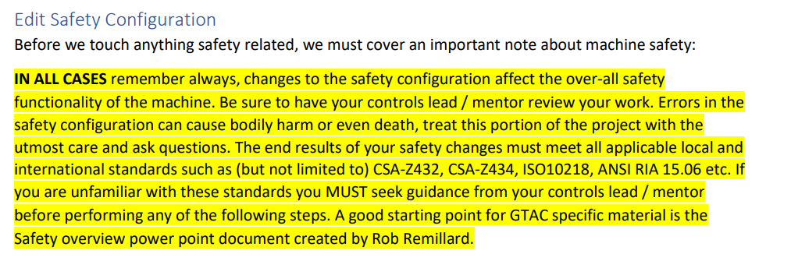
FW Getting Started Guide Note
Due Diligence
Taken from page 42 of the GTAC FW Getting Started Guide, Version 20220606

Slide 15

Thanks for your time

